Slide 1
Welcome!
Sunday
Worship 10:00 AM
Sunday
Bible Class (Livestream) 5:00 PM
Wednesday
Bible Class 7:00 PM
www.SunsetchurchofChrist.net

Slide 2
Opening Prayer | Craig Foster
Song – 433 | George Watkins
Song – 249 | George Watkins
Song – 160 | George Watkins
Lord’s Supper | Rob Wade
Song – 630 | George Watkins
Song – 380 | George Watkins
Lesson | Brian Haines
Song – 284 | George Watkins
Closing | Michael Hetzer
1 Corinthians 16:2
On the first day of the week let each one of you lay something aside, storing up as he may prosper, that there be no collections when I come.
A collection basket
is in the foyer

Slide 3
The End
Notes:
Story of the Preacher in Tucumcari who died preaching “What if this were your last day”

Slide 4
The End
Our Death

Slide 5
The End
Our Death
The Lord’s Return

Slide 6
The End
The Lord’s Return

Slide 7
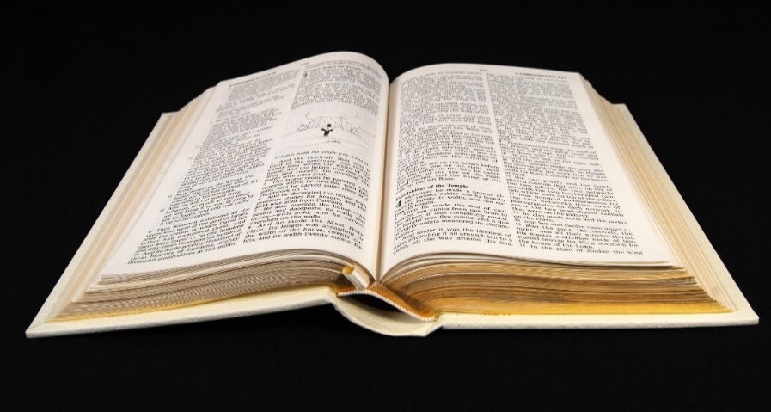
Then Comes the End
But each one in his own order: Christ the firstfruits, afterward those who are Christ’s at His coming. Then comes the end, when He delivers the kingdom to God the Father, 1 Corinthians 15:23-24

Slide 8
Then Comes the End
1 Thessalonians 4:15-5:2 Resurrection
Notes:
¹⁵ For this we say to you by the word of the Lord, that we who are alive and remain until the coming of the Lord will by no means precede those who are ^{[d]}asleep. ¹⁶ For the Lord Himself will descend from heaven with a shout, with the voice of an archangel, and with the trumpet of God. And the dead in Christ will rise first. ¹⁷ Then we who are alive and remain shall be caught up together with them in the clouds to meet the Lord in the air. And thus we shall always be with the Lord. ¹⁸ Therefore comfort one another with these words. 5:1 But concerning the times and the seasons, brethren, you have no need that I should write to you. ² For you yourselves know perfectly that the day of the Lord so comes as a thief in the night.

Slide 9
Then Comes the End
1 Thessalonians 4:15-5:2 Resurrection
2 Peter 3:10-13 Destruction
Notes:
¹⁰ But the day of the Lord will come as a thief in the night, in which the heavens will pass away with a great noise, and the elements will melt with fervent heat; both the earth and the works that are in it will be ^{[d]}burned up. ¹¹ Therefore, since all these things will be dissolved, what manner of persons ought you to be in holy conduct and godliness, ¹² looking for and hastening the coming of the day of God, because of which the heavens will be dissolved, being on fire, and the elements will melt with fervent heat?

Slide 10
Then Comes the End
1 Thessalonians 4:15-5:2 Resurrection
2 Peter 3:10-13 Destruction
Matthew 25:31-33 Judgment
Notes:
¹ “When the Son of Man comes in His glory, and all the ^{[c]}holy angels with Him, then He will sit on the throne of His glory. ³² All the nations will be gathered before Him, and He will separate them one from another, as a shepherd divides his sheep from the goats.

Slide 11
Then Comes the End
1 Thessalonians 4:15-5:2 Resurrection
2 Peter 3:10-13 Destruction
Matthew 25:31-33 Judgment
Revelation 20:11-14 Eternity
Notes:
¹¹ Then I saw a great white throne and Him who sat on it, from whose face the earth and the heaven fled away. And there was found no place for them. ¹² And I saw the dead, small and great, standing before ^{[c]}God, and books were opened. And another book was opened, which is the Book of Life. And the dead were judged according to their works, by the things which were written in the books. ¹³ The sea gave up the dead who were in it, and Death and Hades delivered up the dead who were in them. And they were judged, each one according to his works. ¹⁴ Then Death and Hades were cast into the lake of fire. This is the second ^{[d]}death. ¹⁵ And anyone not found written in the Book of Life was cast into the lake of fire.

Slide 12
Before the Last Day
No one is in heaven OR hell yet
No one is in heaven except Jesus – John 1:18
No one is in hell – 2 Peter 2:17, 3:7
Not even the Devil – 1 Peter 5:8
Notes:
1 Pet 5:8 Be sober, be vigilant; because your adversary the devil walks about like a roaring lion, seeking whom he may devour.
John 1:18 No one has seen God at any time. The only begotten ^{[h]}Son, who is in the bosom of the Father, He has declared Him.

Slide 13
What Won’t Matter
Your wealth and success
Luke 16:19-23
James 5:1-4
Notes:
Lu 16:19 ¶ "There was a certain rich man who was clothed in purple and fine linen and fared sumptuously every day. 20 "But there was a certain beggar named Lazarus, full of sores, who was laid at his gate,
21 "desiring to be fed with the crumbs which fell from the rich man's table. Moreover the dogs came and licked his sores. 22 "So it was that the beggar died, and was carried by the angels to Abraham's bosom. The rich man also died and was buried. 23 "And being in torments in Hades, he lifted up his eyes and saw Abraham afar off, and Lazarus in his bosom.
Jas 5:1 ¶ Come now, you rich, weep and howl for your miseries that are coming upon you! 2 Your riches are corrupted, and your garments are moth-eaten. 3 Your gold and silver are corroded, and their corrosion will be a witness against you and will eat your flesh like fire. You have heaped up treasure in the last days. 4 Indeed the wages of the laborers who mowed your fields, which you kept back by fraud, cry out; and the cries of the reapers have reached the ears of the Lord of Sabaoth.

Slide 14
What Won’t Matter
Your wealth and success
Your popularity and power
Matthew 16:26
Notes:
Mt 16:26 "For what profit is it to a man if he gains the whole world, and loses his own soul? Or what will a man give in exchange for his soul?

Slide 15
What Won’t Matter
Your wealth and success
Your popularity and power
That you know Jesus
Matthew 7:21
Notes:
Mt 7:21 ¶ "Not everyone who says to Me, 'Lord, Lord,' shall enter the kingdom of heaven, but he who does the will of My Father in heaven.

Slide 16
What Won’t Matter
Your wealth and success
Your popularity and power
That you know Jesus
That you did good works
Matthew 7:22
Notes:
Mt 7:21 ¶ "Not everyone who says to Me, 'Lord, Lord,' shall enter the kingdom of heaven, but he who does the will of My Father in heaven. 22 "Many will say to Me in that day, 'Lord, Lord, have we not prophesied in Your name, cast out demons in Your name, and done many wonders in Your name?' 23 "And then I will declare to them, 'I never knew you; depart from Me, you who practice lawlessness!'

Slide 17
What Won’t Matter
Your wealth and success
Your popularity and power
That you know Jesus
That you did good works
That you followed good people
Matthew 7:13-15
Notes:
Mt 7:13 "Enter by the narrow gate; for wide is the gate and broad is the way that leads to destruction, and there are many who go in by it. 14 "Because narrow is the gate and difficult is the way which leads to life, and there are few who find it. 15 ¶ "Beware of false prophets, who come to you in sheep's clothing, but inwardly they are ravenous wolves.

Slide 18
Dismissed by God
“Depart from me, I know you not”
“Go away into everlasting punishment”
“Bind him hand and foot, take him away, and cast him into outer darkness; there will be weeping and gnashing of teeth.”

Slide 19
What Will Matter
That you have remained clothed in Christ
Revelation 16:15
Galatians 3:27
Notes:
Re 16:15 "Behold, I am coming as a thief. Blessed is he who watches, and keeps his garments, lest he walk naked and they see his shame.“
Ga 3:27 For all of you who were baptized into Christ have clothed yourselves with Christ.

Slide 20
What Will Matter
That you have remained clothed in Christ
That you served other Christians
Matthew 25:31-46

Slide 21
What Will Matter
That you have remained clothed in Christ
That you served other Christians
That you remained pure and undefiled
James 1:27
Notes:
Jas 1:27 Pure and undefiled religion before God and the Father is this: to visit orphans and widows in their trouble, and to keep oneself unspotted from the world.

Slide 22
What Will Matter
That you have remained clothed in Christ
That you served other Christians
That you remained pure and undefiled
That you were a worshipper of God
John 9:31
Hebrews 10:26
Notes:
Be sober, be vigilant; because your adversary the devil walks about like a roaring lion, seeking whom he may devour.
¹⁸ No one has seen God at any time. The only begotten ^{[h]}Son, who is in the bosom of the Father, He has declared Him.

Slide 23
Being Ready For That Day
The day will come like a thief
You will not expect it
No signs or wonders
A day like any other
Being ready means you are ready NOW

Slide 25
Ready For the Day
Jesus is returning for those who:
Have believed
Have confessed Him
Have turned from sin
Have been baptized
Have remained faithful
Is that YOU?

Slide 26
Pu

